Slide 1
Satellites & Education Conference
August 1, 2014
GOES-R Activities
with
Craig Phillips
and
Brian Witthun

Slide 2
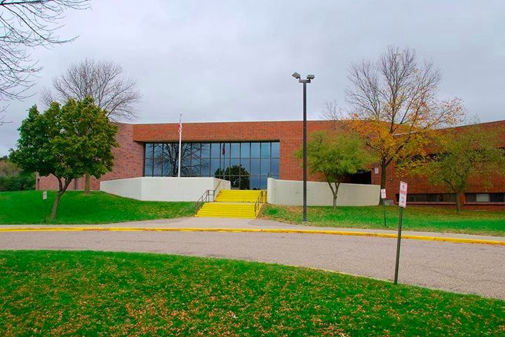
JYMS serves approximately 700 students in grades 6 - 8 Minority: 10.8% Economically Disadvantaged: 46%
Special Education: 13.6%
JY

Slide 3
Introduction
We were asked to develop activities for the Geostationary Operational Environmental Satellite - R series (GOES-R) which is scheduled to be launched in 2016.

Slide 4
Our Goals
1. Explore satellite orbits.
2. Look at the function and importance of the GOES-R ABI.
3. Compare GOES-R capabilities to current satellites.

Slide 5
We developed 3 activities and teacher answer keys:
Activity 1 and Answer Key 1

Slide 6
We developed 3 activities and teacher answer keys:
Activity 2 and Answer Key 2
GOES-R Instrument Chart and Chart Answer Key

Slide 7
We developed 3 activities and teacher answer keys:
Activity 3 and Answer Key 3

Slide 8
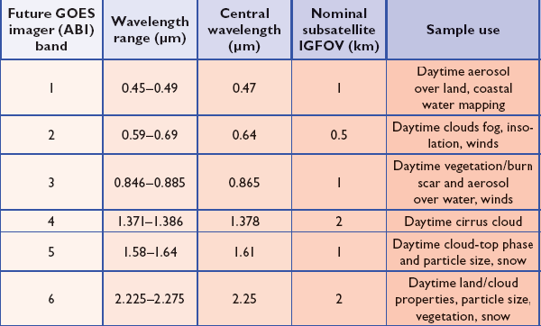
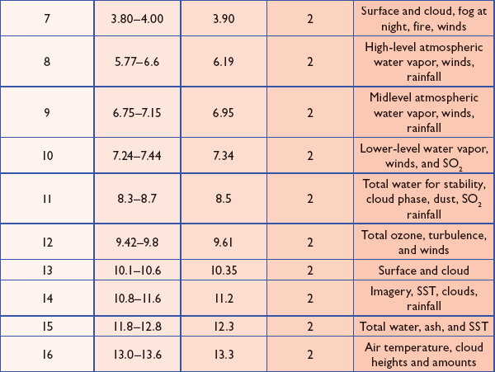
We included more information on the ABI spectral capabilities in Activity 4.

Slide 9
Extension Activities
GOES-R Student Extension and Exploration Activities.

Slide 10
Activity Results
Overall, students enjoyed the activities. Several students referred back to the activities later in the year.
We asked students for suggestions for improvements.
Some students struggled with the reading and interpretation of text and videos.

Slide 11
Please email us If you would like these activities shared with you electronically.
cphillips@barabooschools.net
bwitthun@barabooschools.net

